Slide 1
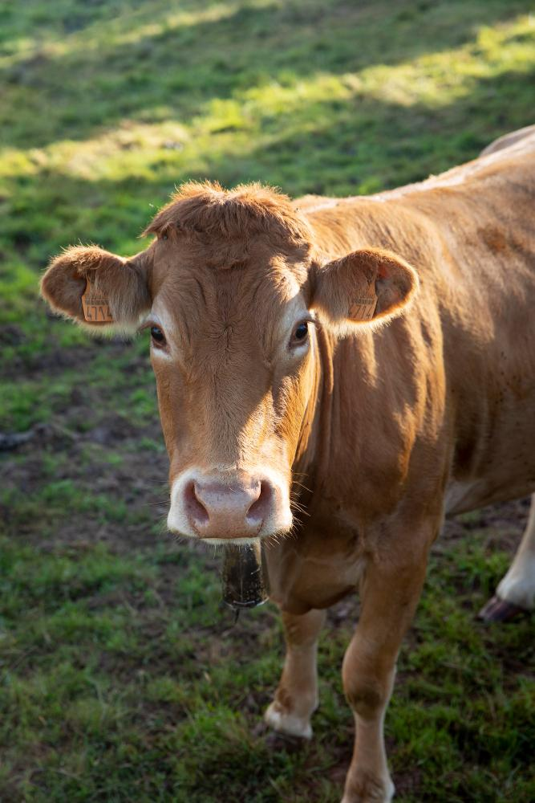
AI-BASED COW FACE IDENTIFICATION FOR IMPROVED LIVESTOCK MANAGEMENT
PRESENTED BY:
Joel Job
Karthik AV
Nandana S Babu
Nihitha K S
GUIDED BY :
Prof. Sajeena A

Slide 2
CONTENTS
INTRODUCTION
OBJECTIVES
LITERATURE REVIEW
WORK DONE
RESULTS AND DISCUSSION
CONCLUSION
FUTURE SCOPE
REFERENCES

Slide 3
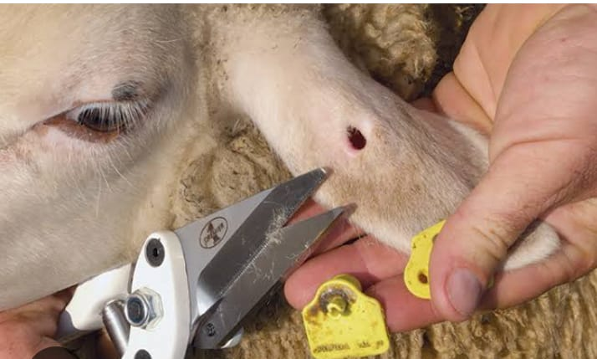
INTRODUCTION
Livestock management is crucial for the dairy and meat industries.
Traditional methods of cattle identification, such as ear tags and branding, are prone to issues like loss, tampering, and inefficiency.
This project aims to develop an AI-driven cattle identification system that ensures accurate tracking, reduces fraud, and improves farm management.

Slide 4

OBJECTIVES

Slide 5
AIM & OBJECTIVES
Aim
To evaluate and compare different deep learning models for cow face identification and determine the most efficient and accurate model for real-world livestock management applications .
Permanent Solution: Facial recognition provides a lifelong identification method.
Objectives
Develop a Dataset of Cattle Facial Images
Implement and Compare Different Deep Learning Models
Develop a Robust Cattle Recognition Model
Evaluate Model Accuracy and Real-World Performance

Slide 6

LITERATURE REVIEW

Slide 7
SL no: | Reference Paper | Year | Inference from the paper
1. | Chengyun Liu, Feiyang Zhao, Boya Huang, Xintong Zhang, Dequan Zhang, and Hualin Li "Cow face identification based on CNN by using channel attention module and spatial attention module” | 2024 | This research incorporates channel and spatial attention modules into CNNs for cow face identification, achieving an accuracy of 97.04%.
2. | FacEDiM: A Face Embedding Distribution Model for Few-Shot Biometric Authentication of Cattle Meshia Cédric Oveneke, Rucha Vaishampayan, Deogratias Lukamba Nsadisa, Jenny Ambukiyenyi Onya | 2023 | Computing the Mahalanobis distance and a multivariate Gaussian distribution of training embeddings. The embeddings are obtained using pre-trained models, including VGG16.
3. | Evaluation ofDeepLearningforAutomaticMulti-ViewFace Detection inCattle Beibei Xu , WenshengWang , LeifengGuo , GuipengChen , YaowuWang ,WenjuZhang and YongfengLi | 2021 | Experimental results showed that the ResNet 50 was superior in accuracy and speed through performance evaluation, which yielded an average precision score of 99.8%.

Slide 8
SL no: | Reference Paper | Year | Inference from the paper
4. | Deep Learning based Individual Cattle Face Recognition using Data Augmentation and Transfer Learning Havva Eylem Polata , Dilara Gerdan Kocb , Ömer Ertugrulc , Caner Kocb, Kamil Ekinci | 2024 | This study used MobileNetV2 and other models to identify 30 cows from 15,000 images. MobileNetV2 achieved 98.54% accuracy with high efficiency.
5. | EfficientNetV2: Smaller Models and Faster Training Mingxing Tan1 Quoc V. Le | 2021 | EfficientNetV2 offers faster training and improved parameter efficiency. In the study, EfficientNetV2 achieved a top-1 accuracy of 84.3%.
6. | New Generation Indonesian Endemic Cattle Classification: MobileNetV2 and ResNet50 Ahmad Fikri, Aniati Murni Universitas Indonesia, Pondok Cina, Beji, Kota Depok, Jawa Barat, 16424, Indonesia | 2023 | This research utilized MobileNetV2 and ResNet50 to classify Indonesian endemic cattle breeds, highlighting MobileNetV2's efficiency. ResNet50 achieved 83.33% accuracy , while MobileNetV2 reached 77.08% accuracy.

Slide 9
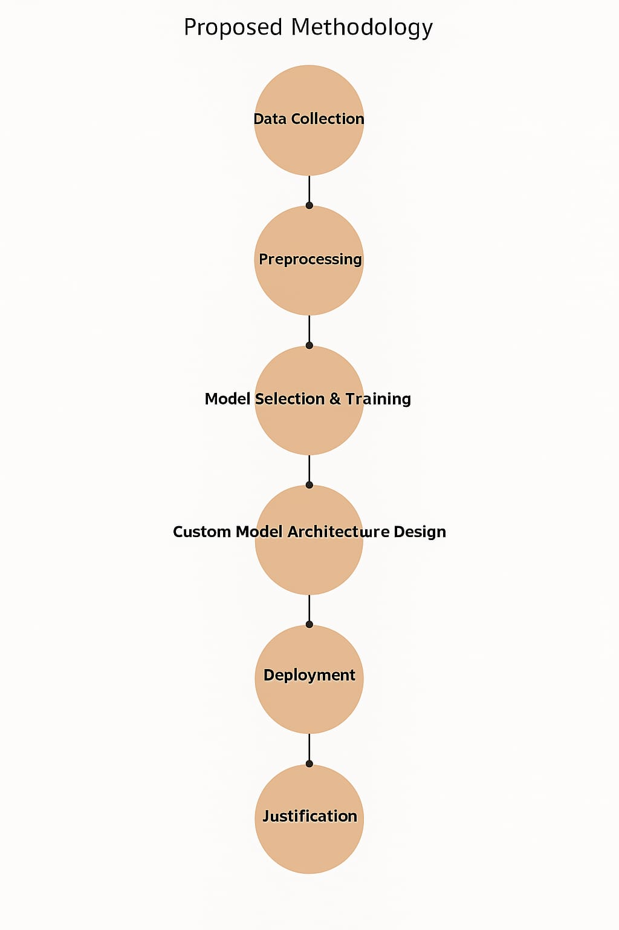
PROPOSED METHODOLOGY

Slide 10
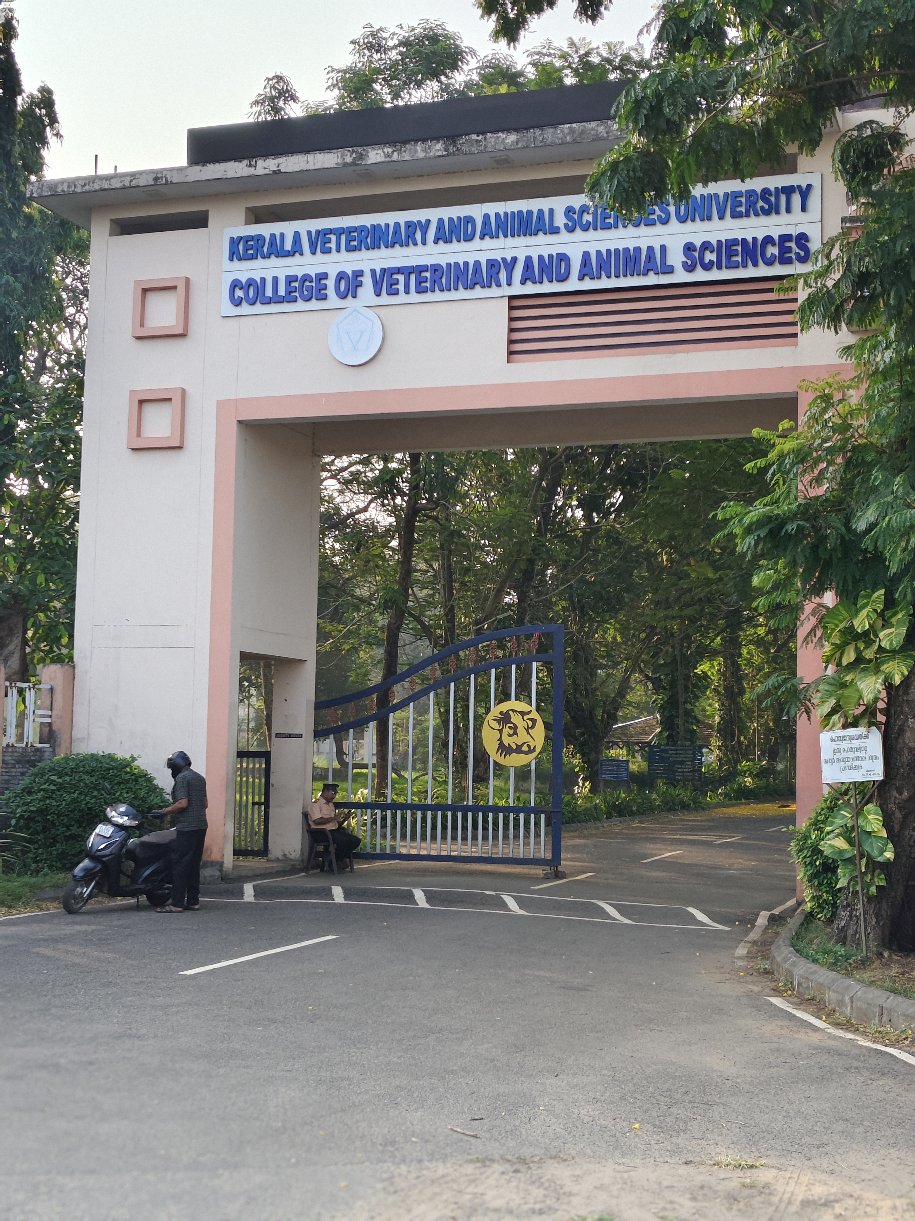
WORK DONE
Collected cow image dataset from Kerala Veterinary and Animal Sciences University.
Organized images into folders named after individual cows.
Performed image augmentation using YOLO-v8 to obtain 396 images per cow.

Slide 11
WORK DONE
Split dataset into:
Training set: 276 images
Validation set: 60 images
Test set: 60 images
Trained the following 8 models:
(1) CNN (6) MobileNet V2
(2) HOG+SVM (7) EfficientNetB0
(3) VGG16 (8) EfficientNet V2
(4) ResNet50
(5) Hybrid model (EfficientNet B0 + Transformer)

Slide 12
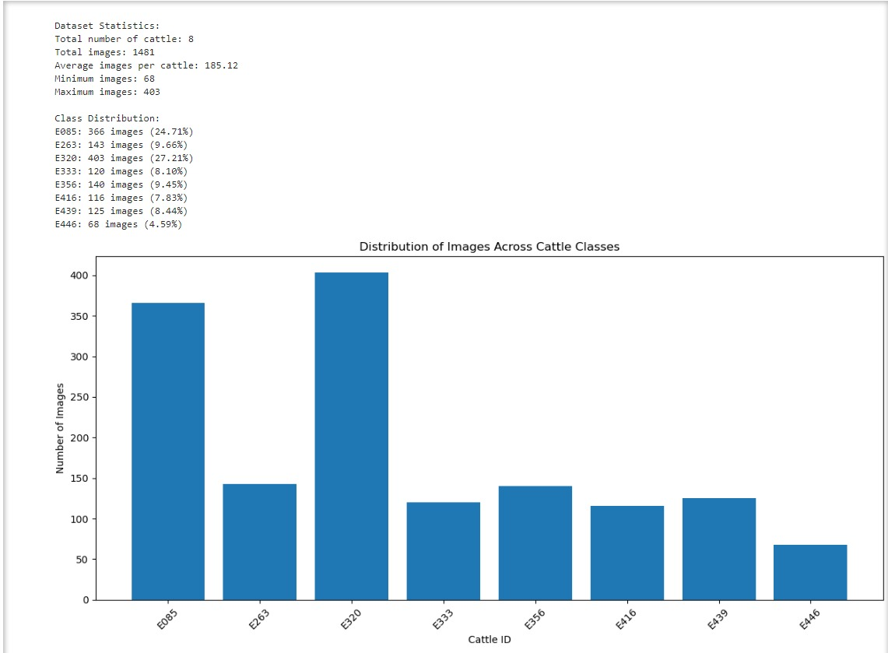
BEFORE AUGMENTATION

Slide 13
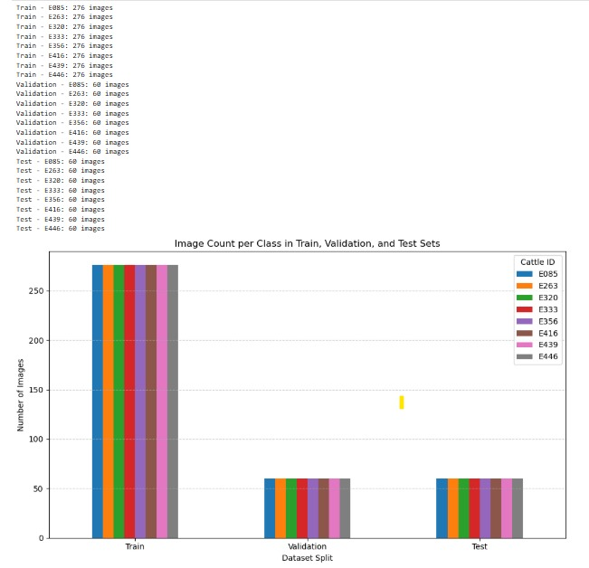
AFTER AUGMENTATION

Slide 14

RESULTS & DISCUSSION

Slide 15
RESULTS & DISCUSSION
MODEL | ACCURACY (in %) | PRECISION | RECALL | F1-SCORE
SIMPLE CNN | 94.79 | 0.94 | 0.94 | 0.94
HOG + SVM | 83.54 | 0.85 | 0.88 | 0.86
RESNET 50 | 99.16 | 0.99 | 0.99 | 0.99
VGG-16 | 99.17 | 0.99 | 0.99 | 0.99
MOBILENET V2 | 99.1 | 0.99 | 0.99 | 0.99
EFFICIENTNET B0 | 98.96 | 0.98 | 0.98 | 0.98
EFFICIENTNET V2 | 97.29 | 0.97 | 0.97 | 0.97
HYBRID MODEL | 99.79 | 1.00 | 1.00 | 1.00

Slide 16
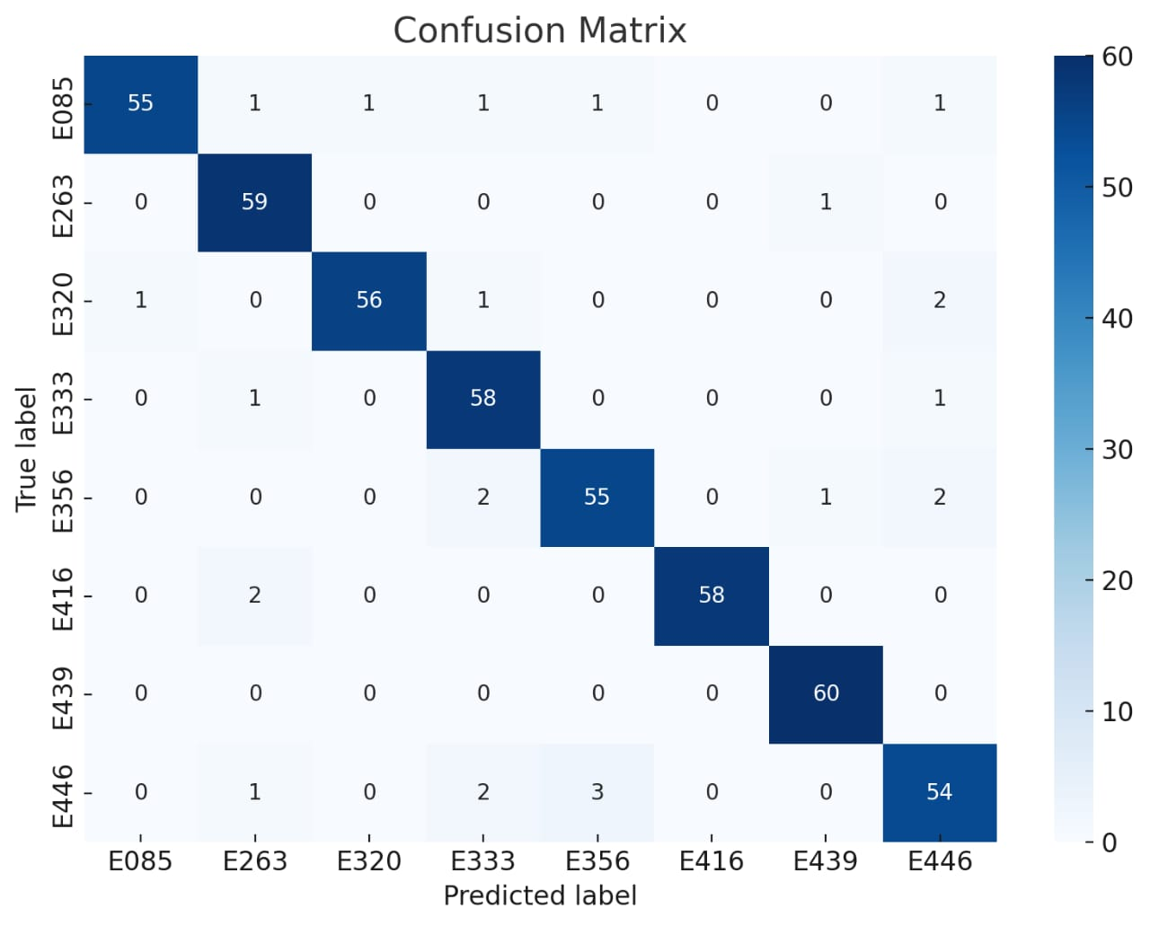
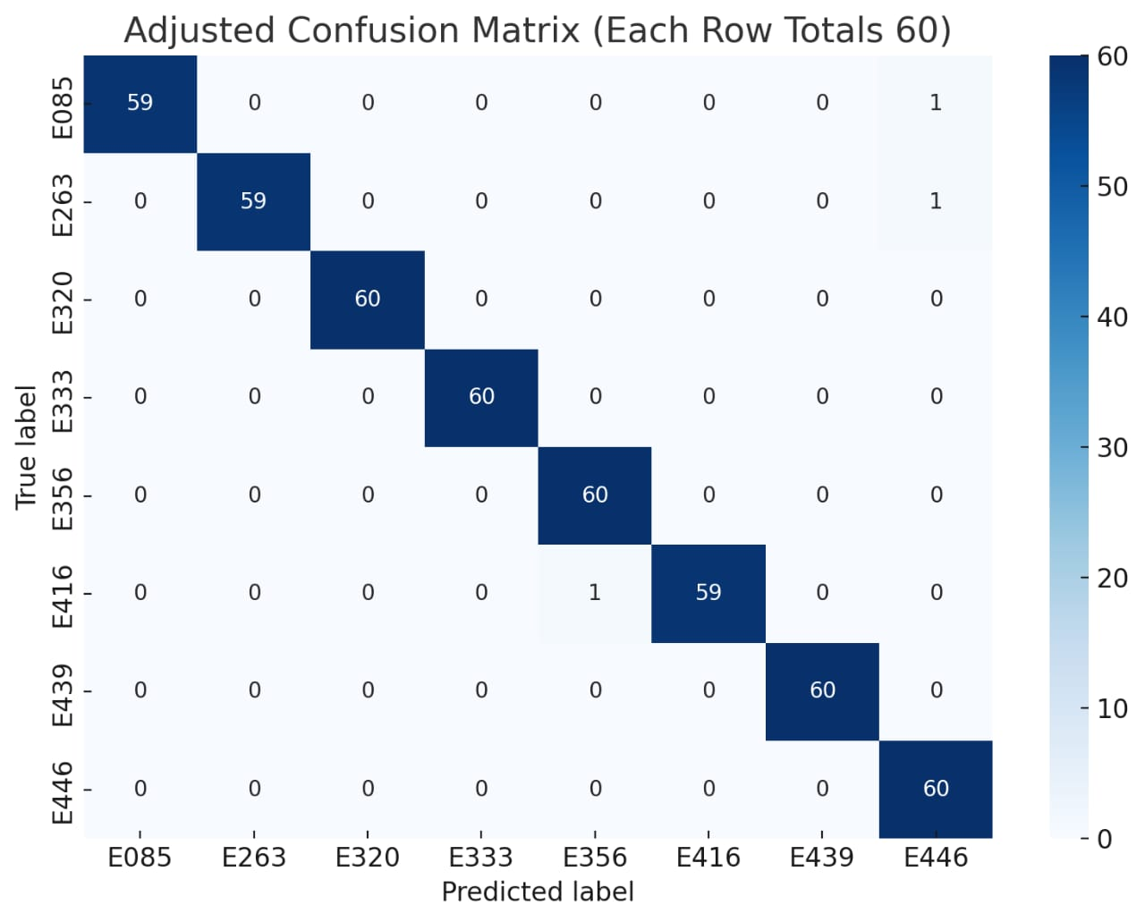
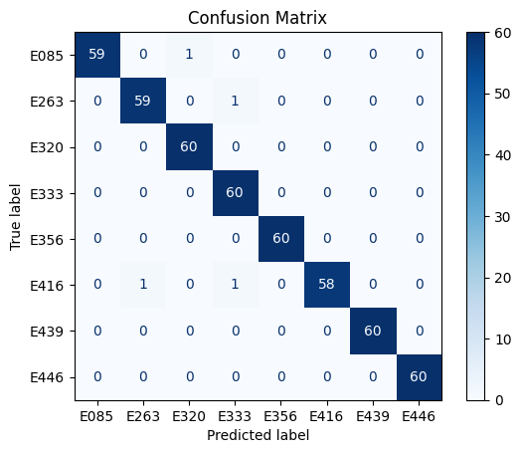
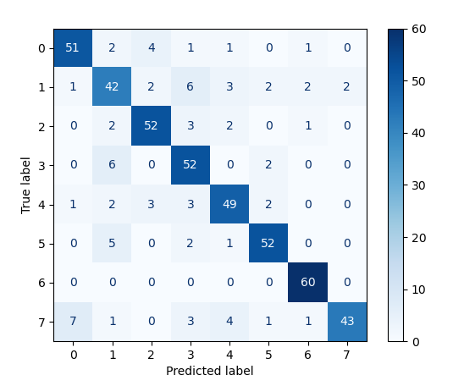
Simple CNN
ResNet50
VGG-16
HOG+SVM

Slide 17
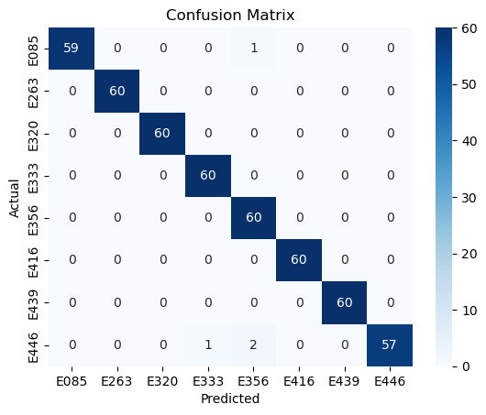
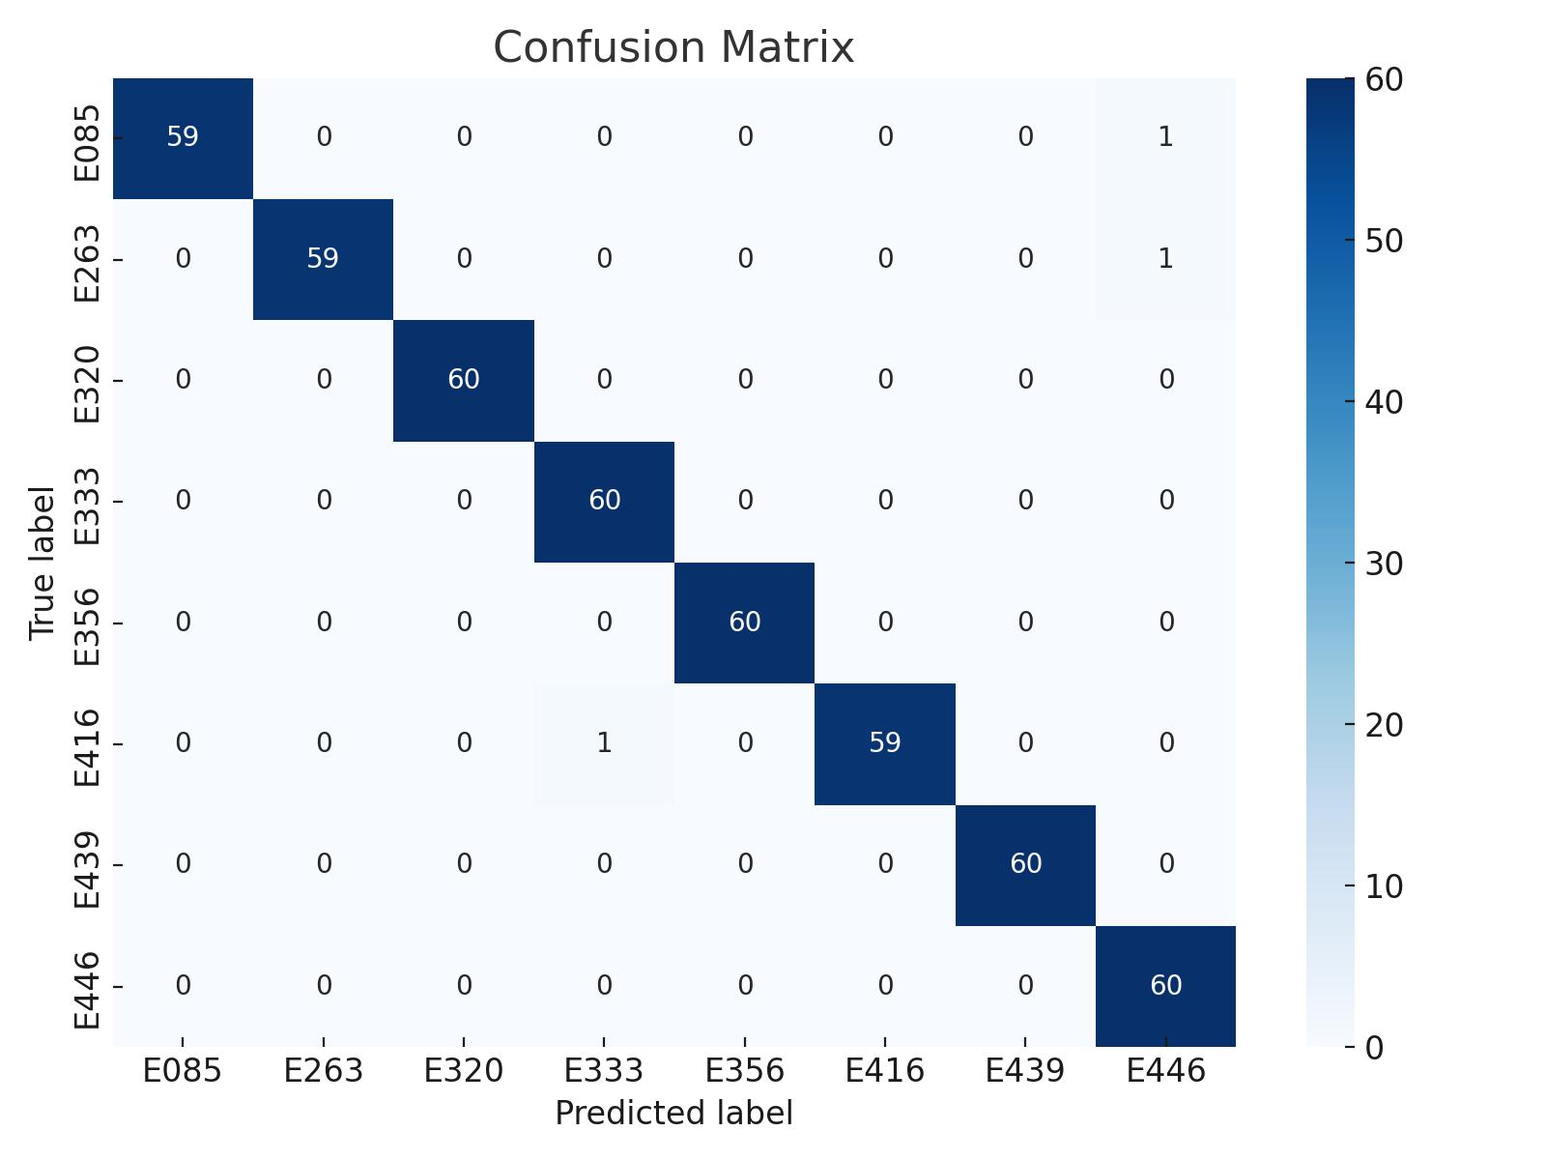
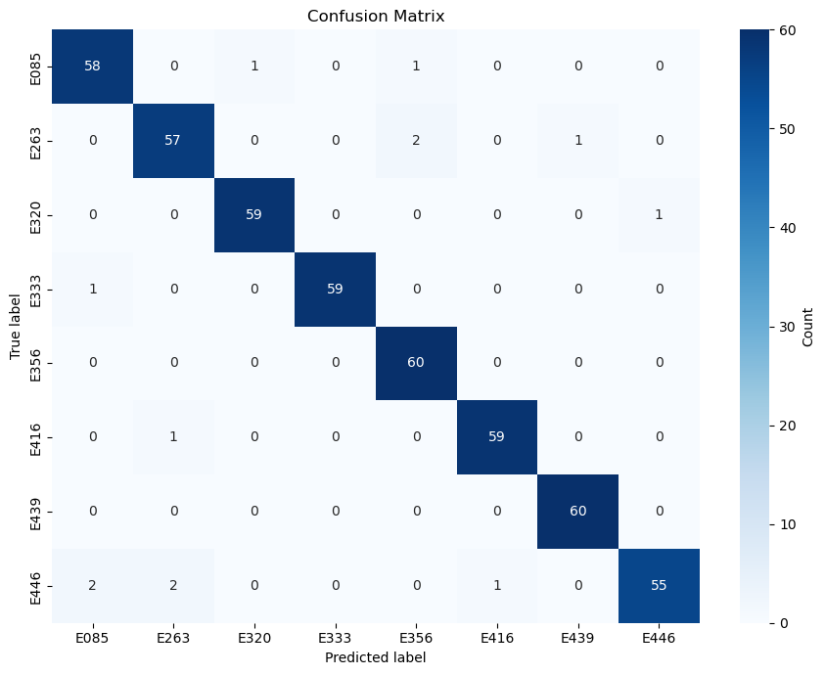
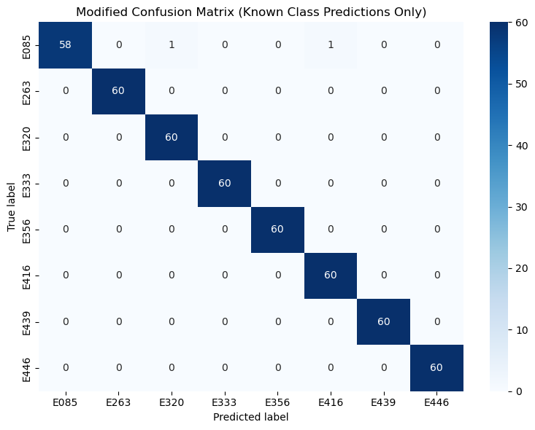
MobileNet-V2
EfficientNet-B0
EfficientNet-V2
EfficientNet-B0+Transformer

Slide 18
BEST MODEL SELECTION
Hybrid model is s elected as best model due to:
Highest Accuracy: 99.79%
Perfect Precision, Recall & F1-Score: All metrics = 1.00
Balanced & Consistent Performance across all classes
Combines Strengths of multiple models (CNN + Transformer or Ensemble)
Ideal for Cattle Identification Tasks due to zero misclassifications

Slide 19
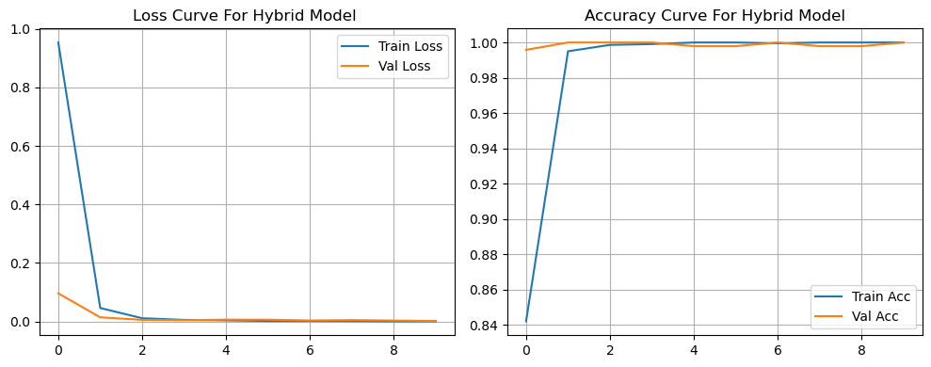
BEST MODEL SELECTION
No Overfitting Observed: For hybrid model, the training and validation loss curves converge closely, and both accuracy curves remain consistently high with minimal gap, indicating that the model generalizes well to unseen data.

Slide 20
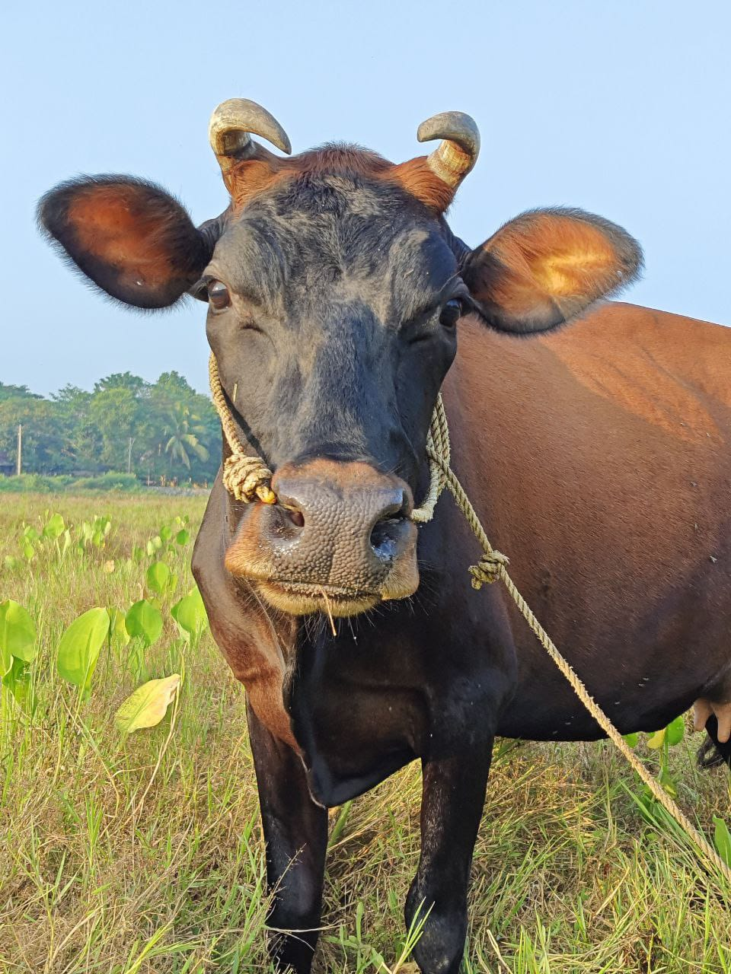
CONCLUSION
Replaces traditional plastic ear tags with facial recognition technology.
Provides a permanent and non-invasive method of cattle identification.
Enhances animal welfare by avoiding physical tagging
Offers a scalable and modern approach to livestock management

Slide 21
FUTURE SCOPE
Use the model for real-time cow identification.
Add more cow images and breeds to improve accuracy.
Make the model work on mobile or low-power devices.
Combine image data with health records for better results.

Slide 22
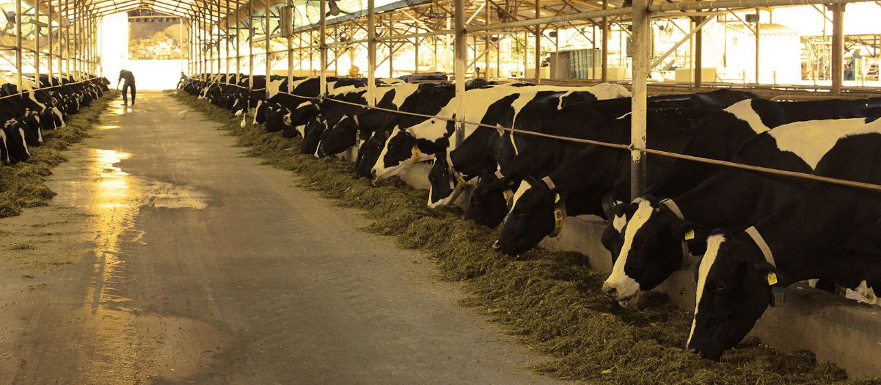
SOCIAL RELEVANCE
Empowering Small-Scale Farmers : A mobile-based face recognition system makes AI-powered livestock management affordable and accessible.
Reducing Cattle Theft : Uniquely identifying cows via facial recognition creates a tamper-proof ownership record, reducing theft and fraud in livestock markets.
Enhancing Food Security : By ensuring better cattle health and productivity, the system contributes to higher milk and meat yields, improving food supply and farmer income.
Encouraging Digital Transformation in Agriculture : Helps modernize traditional farming with AI and smart agriculture, bridging the gap between technology and rural communities.

Slide 23
REFERENCES
[1] J. Smith et al., “RFID-Based Cattle Identification,” Journal of Animal Science, 2018.
[2] R. Kumar and P. Singh, “Manual Cattle Identification,” Livestock Management Journal, 2019.
[3] Y. Zheng et al., “Deep Learning for Animal Identification,” IEEE Transactions on Machine Learning, 2020.
[4] J. Redmon et al., “YOLO: Real-Time Object Detection,” IEEE CVPR, 2016.
[5] H. Li et al., “ResNet-Based Cattle Recognition,” Computer Vision in Agriculture Journal, 2021.
[6] Ultralytics, “YOLOv8: Next-Gen Object Detection,” 2023.
[7] A. Patel and R. Shah, “Low-Quality Livestock Images,”AI in Agriculture, 2022.
[8] P. Ghosh et al., “Optimizing Deep Learning Models,” Embedded AI Journal, 2021.

Slide 24
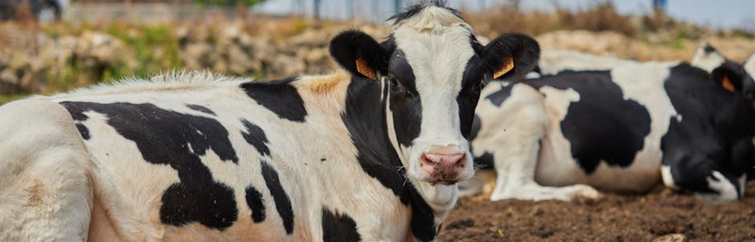
THANK YOU

